Slide 1
Echo state networks
ESNs consist of three layers: input, reservoir, and output.
The input layer receives the input sequence, which is then fed into the reservoir layer, which consists of a large number of recurrently connected neurons.
The reservoir layer generates a high-dimensional, nonlinear and dynamic internal representation of the input, which is then transformed into an output sequence by the output layer.

Slide 2
One key feature of ESNs is that the weights of the connections between the input and the reservoir layer, as well as the connections within the reservoir layer, are randomly generated and remain fixed during training.
Only the weights between the reservoir and output layer are learned using a linear regression algorithm.

Slide 3
What is ESN?
the weights between the input -the hidden layer ( the ‘reservoir’) : Win and also the weights of the ‘reservoir’: Wr are randomly assigned and not trainable.
the weights of the output neurons (the ‘readout’ layer) are trainable and can be learned so that the network can reproduce specific temporal patterns.
the hidden layer (or the ‘reservoir’) is very sparsely connected (typically < 10% connectivity)

Slide 4
The reservoir architecture creates a recurrent non linear embedding of the input which can be then connected to the desired output and these final weights will be trainable.
The reservoir layer is typically constructed using a random sparse matrix of connection weights, such as a random Bernoulli or Gaussian distribution.
This means that the reservoir layer has a large number of degrees of freedom, which allows it to generate a high-dimensional, nonlinear and dynamic internal representation of the input data

Slide 5
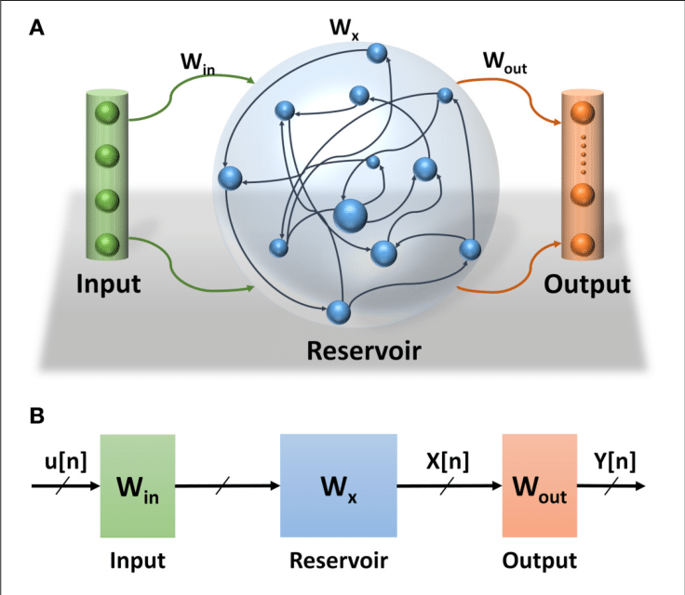

Slide 6
Why ESN network?
Echo State Networks are very fast as there is no back propagation phase on the reservoir.
ESN are well adapted for handling chaotic time series.
Don’t not suffer vanishing/exploding gradient problem.

Slide 7
Applications
ESNs have been successfully applied to a wide range of tasks, including time-series prediction, speech recognition, and image recognition.
They are particularly effective when the input data has a complex temporal structure and when there is a need for real-time processing.

